Slide 1
Game AI (Game Engines 2) Implementing the Behaviours in Unity3D
Dr Bryan Duggan
Dublin Institute of Technology

Slide 2
What we will learn today
Unity basics
The framework code for the examples on this course
Implementing steering behaviours in Unity

Slide 3




Unity is an platform for making games
Features
Game engine
Scene editor
3D or 2D Games
GameObjects, GameComponents
PhysX and Box2D physics
Class library
Bindings for C#, Boo and JavaScript
Uses MONO (Open Source .Net)
Runtimes for PC, Mac, Linux, IOS, Android etc etc.

Slide 4
In industry
Huge presence at GDC
Very popular amongst indies
Free & Pro versions
Free for games up to 100K
Pro version has a few extra features
Including Rift support
Pro version is expensive
75 Euro PM

Slide 5
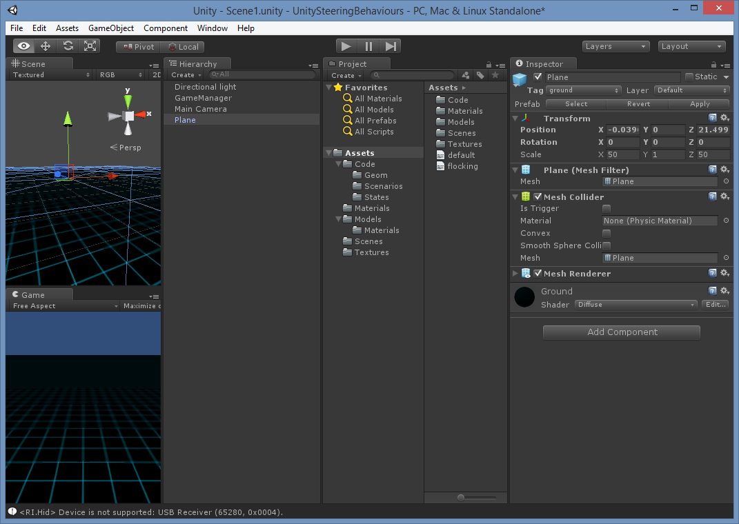

Slide 6
Concepts
GameObject
Represents anything in the scene
Has a Transform object
Does not draw itself! (Thats what a GameComponent is for)
Can contain other GameComponents
Can be attached to other GameObject’s
Parent’s transform is multiplied into the child’s
You rarely extend GameObject
GameComponent
Contained by a GameObject (GameObject’s can have multiple GameComponents attached)
Start – Called at the start of the lifetime
Update – Called once per frame
Use Time.deltaTime to get the time delta

Slide 7
Concepts
Transform
Contains forward, up and right vectors
A quaternion called rotation
A position vector
Probably has a world transform, but its not visible?
This is the object that controls the GameObject’s world transform
Renderer
A subclass of GameComponent
There are lots of subclasses for different types of drawable object

Slide 8
Useful Classes
Vector3
x, y, z fields (lowercase)
+, -, * / overloaded
magnitude (lowercase)
Dot, Cross, Normalize (static methods)
Use the static fields forward, right and up to get the basis vectors
Quaternion
w, x, y, z fields (lowercase)
* is overloaded for quaternions and vectors
* a vector rotates the vector by the quaternion
Use:
Quaternion q = Quaternion.AngleAxis(90, Vector3.up);
To make one!
Angle is in degrees

Slide 9
Matrix operations
Are not supported!
Instead use a quaternion for rotations and
Transform object for everything else (including rotations)
E.g:
Vector3 target = Vector3.zero;
target = leader.transform.TransformPoint(offset);
To transform a point by the transform
Also:
TransformDirection
InverseTransformDirection
InverseTransformPoint

Slide 10
Creating GameObjects in code..
Create a “prefab” (a game object with some components attached)
This is done automatically when you import a model
Create a public field in the game component
This exposes the field to the Unity editor
Drag the prefab over to the field in the editor
Write code:
boid = (GameObject) GameObject.Instantiate(prefab);
boid.tag = "boid";
boid.AddComponent<SteeringBehaviours>();
boid.transform.position = position;

Slide 11
Referencing other GameObjects/GameComponents
Use the tag to assign a string tag to the object
Use:
GameObject[] obstacles = GameObject.FindGameObjectsWithTag("obstacle");
GameObject obstacles = GameObject.FindGameObjectWithTag("obstacle");
Use:
leader.GetComponent<SteeringBehaviours>()
To get a component of a GameObject

Slide 12
Debugging C# Code
Can’t use VisualStudio without an expensive plugin
Instead use MonoDevelop
The .sln .csproj files get regenerated each time you build your project
Add these to your .gitignore file
Set breakpoints etc in MonoDevelop
Choose Run | Attach to Process in MonoDevelop
Unity must be already running but not running your project
Run the project in Unity

Slide 13
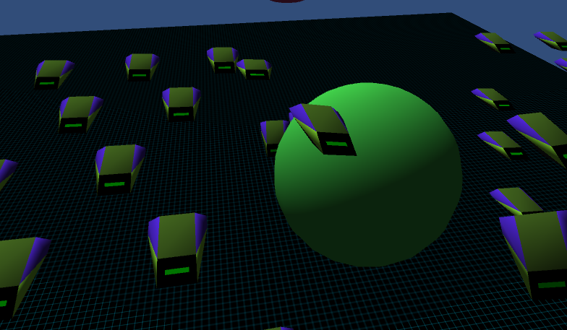
My Game AI Framework!

Slide 14
Main Classes
SteeringBehaviours
A GameComponent
Implements all the behaviours!
You must call Params.Load before using
Uses bit masking to control which behaviours are turned on
SteeringManager
A singleton
Attached to a GameObject with no renderer
Used to control which scenario is run
Displays the HUD
Handles turning on and off various display settings
Exposes the prefabs required by the scenarios
Should not be necessary if you are using the Unity editor to create scenes

Slide 15
Main Classes
Scenario
Base class for each of the demos
Has Setup, Update and TearDown methods
Handles mouse clicks to move the targetPos of the behaviours
leader is a special game object
TearDown removes all the objects from the scene
Special tags!
Boid, obstacle, MainCamera

Slide 16
Subclasses
SeekScenario
ArriveScenario
PursueScenario
StateMachineScenario
PathFollowingScenario
PathFindingScenario
ObstacleAvoidanceScenario

Slide 17
Bitmasking
Allows you to store lots of booleans in a single int value
First create a mask with the bit you want
int mask = 1 << 5
Operations
Set a bit
OR with the mask
Clear a bit
AND with the inverse of the mask
Toggle a bit
XOR with the mask
Read a bit
AND with the mask and check for non zero

Slide 18
In code:
public bool isOn(behaviour_type behaviour)
{
return ((flags & (int)behaviour) == (int)behaviour);
}
public void turnOn(behaviour_type behaviour)
{
flags |= ((int)behaviour);
}
public void turnOff(behaviour_type behaviour)
{
flags &= ( ~ (int)behaviour);
}

Slide 19
Offset pursuit (3D)
Used to program fleets (amongst other things)
Similar to pursue but with 2 differences
The agent pursues an offset (in local space) of the target agent
Transform the offset by the target agents Transform object to get the target
Use dead reckoning same as pursue
We use arrive instead of seek to keep in “formation”

Slide 20
Code...
Vector3 OffsetPursuit(Vector3 offset)
{
Vector3 target = Vector3.zero;
target = leader.transform.TransformPoint(offset);
float dist = (target - transform.position).magnitude;
float lookAhead = (dist / Params.GetFloat("max_speed"));
target = target + (lookAhead * leader.GetComponent<SteeringBehaviours>().velocity);
checkNaN(target);
return Arrive(target);
}

Slide 21
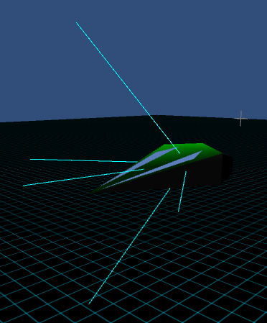
Wall Avoidance (3D)
Uses “feelers”
Points projected in front of the agent
3 for 2D 5 for 3D
Make them in local space
Use the forward basis vector and a quaternion to make them
Transform to world space
Can use Plane geometry to check the points against the plane
If any are on the far side of the plane
Calculate the distance
Cenerate a force perpendicular to the plane

Slide 22
In code...
Vector3 newFeeler = Vector3.forward * feelerDistance;
newFeeler = transform.TransformPoint(newFeeler);
Feelers.Add(newFeeler);
newFeeler = Vector3.forward * feelerDistance;
newFeeler = Quaternion.AngleAxis(45, Vector3.up) * newFeeler;
newFeeler = transform.TransformPoint(newFeeler);
Feelers.Add(newFeeler);
newFeeler = Vector3.forward * feelerDistance;
newFeeler = Quaternion.AngleAxis(-45, Vector3.up) * newFeeler;
newFeeler = transform.TransformPoint(newFeeler);
Feelers.Add(newFeeler);
newFeeler = Vector3.forward * feelerDistance;
newFeeler = Quaternion.AngleAxis(45, Vector3.right) * newFeeler;
newFeeler = transform.TransformPoint(newFeeler);
Feelers.Add(newFeeler);
newFeeler = Vector3.forward * feelerDistance;
newFeeler = Quaternion.AngleAxis(-45, Vector3.right) * newFeeler;
newFeeler = transform.TransformPoint(newFeeler);
Feelers.Add(newFeeler);

Slide 23
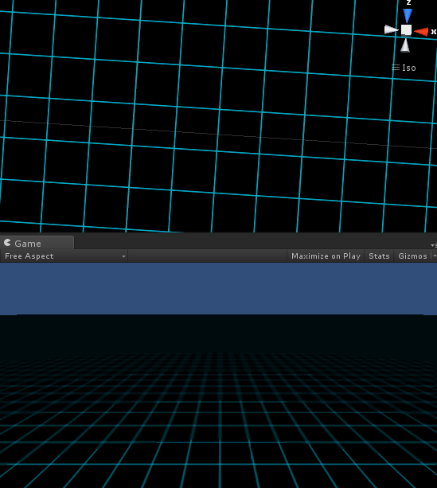
What is a plane?
Infinitely thin
Extends infinitely in all directions
Represented by:
Ax + By + Cz = D
Dont exist in the real world
Though you can consider any flt surface to be a plane
Eg a page
Wall avoidance uses planes (lines in the original paper)

Slide 24
Equation of a plane
https://www.khanacademy.org/math/linear-algebra/vectors_and_spaces/dot_cross_products/v/defining-a-plane-in-r3-with-a-point-and-normal-vector
Remember
Cos(90) = 0, so
If A and B are perpendicular vectors: A.B = 0
The equation of a plane is given by
n.(p – p₀) = 0

Slide 25
Equation of a plane
n.(p-p0) Can be written as:
n.p –n.p0 (Distributive)
We can therefore write the equation as: n.p + D = 0 Where D = -n.p0
D is also shortest signed distance from the origin to the plane
A plane is 4 values A, B, C and D
A, B, C are the normal
D is the shortest signed distance to the plane!

Slide 26
Calculating the ABCD values
http://www.math.washington.edu/~king/coursedir/m445w04/notes/vector/equations.html
Use simultaneous linear equations
Example: P = (1, 1, 1), Q = (1, 2, 0), R = (-1, 2, 1). We seek the coefficients of an equation ax + by + cz = d, where P, Q and R satisfy the equations:
a + b + c = d a + 2b + 0c = d -a + 2b + c = d
Subtracting the first equation from the second and then adding the second equation to the third, we eliminate a to get:
b - c = 0
4b + c = 2d
Adding the equations gives 5b = 2d, or b = (2/5)d, then solving for c = b = (2/5)d and then a = d - b - c = (1/5)d
So the equation (with a nonzero constant left in to choose) is d(1/5)x + d(2/5)y + d(2/5)z = d, so one choice of constant gives x + 2y + 2z = 5

Slide 27
An easier approach..
Use the cross product
Given, P = (1, 1, 1), Q = (1, 2, 0), R = (-1, 2, 1)
First, the normal vector is the cross product of two direction vectors on the plane.
Let one vector be PQ = Q - P = (0, 1, -1) and the other be PR = R - P = (-2, 1, 0). The cross product
(Q - P) x (R - P) = (1, 2, 2) = normal vector A and the equation is A . X = d for some d
Using the method in the example above, we can find d = A . P = 5. Thus the equation is A . X = 5, which is the same as one of the equations in the earlier example.

Slide 28

Useful things to do with planes!
https://www.khanacademy.org/math/linear-algebra/vectors_and_spaces/dot_cross_products/v/point-distance-to-plane
Calculate the distance from a point to a plane
Calculate the side of the plane a point is on
Substitute the point into the equation and check the result
> 0 in front
< 0 behind

Slide 29
Planes in Unity
Use the Plane struct
Construct using the normal and the D value
Plane worldPlane = new Plane(new Vector3(0, 1, 0), 0);
Or using 3 points
API Includes:
GetSide
GetDistanceToPoint

Slide 30
In Code
Plane worldPlane = new Plane(new Vector3(0, 1, 0), 0);
Vector3 force = Vector3.zero;
foreach (Vector3 feeler in Feelers)
{
if (!worldPlane.GetSide(feeler))
{
float distance = Math.Abs(worldPlane.GetDistanceToPoint(feeler));
force += worldPlane.normal * distance;
}
}
More Plane examples in Unity next...

Slide 31
Vector3 p0 = new Vector3(1,1,1);
Vector3 p1 = new Vector3(1,2,0);
Vector3 p2 = new Vector3(-1,2,1);
Plane p = new Plane(p0, p1, p2);
Console.WriteLine(p.normal);
Console.WriteLine(p.distance);
// get two vectors ON the plane
Vector3 onP0 = p2 - p1;
Vector3 onP1 = p0 - p1;
// Calculate the normal (ABC values for the plane)
Vector3 normal = Vector3.Cross(onP0, onP1);
Console.WriteLine(normal);
// Calculate the D value by substituting into the plane equation
float d = normal.x * p0.x + normal.y * p0.y + normal.z * p0.z;
Console.WriteLine(d);
// Make a plane in Unity using the normal and the distance
Plane pl1 = new Plane(new Vector3(0, 1, 0), -5.0f);
// Test to see which side of the plane the point is on
Vector3 testPoint = new Vector3(10, 4, 10);
float side = pl1.normal.x * testPoint.x + pl1.normal.y * testPoint.y + pl1.normal.z * testPoint.z + pl1.distance;
Console.WriteLine(side);
// generate a plane from points
Plane pl2 = new Plane(new Vector3(1, 5, - 1), new Vector3(60, 5, -10), new Vector3(-10, 5, -30));
Console.WriteLine(pl2.normal);
Console.WriteLine(pl2.distance);
// Test to see which side of the plane the point is on using the Unity API
Console.WriteLine(pl2.GetSide(testPoint));
// Calculate the distance using the Unity API
// See https://www.khanacademy.org/math/linear-algebra/vectors_and_spaces/dot_cross_products/v/point-distance-to-plane
// For the maths
Console.WriteLine(pl2.GetDistanceToPoint(testPoint));

Slide 32

Aside.. Intersection between a ray and a plane
A 3D line
A point and a direction
Equation of a ray will give you any point on the ray
You can plug a point into the equation and see if it is on the ray

Slide 33
Algorithm...
Given a ray p(t) = p₀ + tu
p = a 3D point
t = Distance from the origin to the point
u = direction
And a plane n.p + d = 0
We first solve for t by plugging the ray into the plane:
n.(p₀ + tu) + d = 0 n.p0 + n.tu + d = 0 n.tu = -d – n.p₀ t(n.u) = -d – n. p₀ t = -d – n. p₀ / (n.u)
If t is > 0, the ray intersects the plane
If t < 0, the ray does not intersect the plane

Slide 34
In code:
public bool rayIntersects(Ray ray, out Vector3 point)
{
// Calculate t
float t;
t = (- worldPlane.D - Vector3.Dot(worldPlane.Normal, ray.Position)) / (Vector3.Dot(worldPlane.Normal, ray.Direction));
if (t >= 0)
{
point = ray.Position + (ray.Direction * t);
return true;
}
else
{
point = Vector3.Zero;
return false;
}
}
Or...

Slide 35
In Unity...
Plane worldPlane = new Plane(new Vector3(0, 1, 0), 0);
UnityEngine.Ray ray = new UnityEngine.Ray(camera.transform.position, camera.transform.forward);
float distance = 0;
if (worldPlane.Raycast(ray, out distance))

Slide 36
Spherical containment
Calculate the distance from the centre to the feeler
If > radius then
Calculate the normal
(feeler – centre) and normalise
Calculate the force
n * (radius – distance)

Slide 37
In Code
public Vector3 SphereConstrain(float radius)
{
float distance = transform.position.magnitude;
Vector3 steeringForce = Vector3.zero;
if (distance > radius)
{
steeringForce = Vector3.Normalize(transform.position) * (radius - distance);
}
return steeringForce;
}

Slide 38
Wander
Produce a steering force that will give the impression of a random walk through the agent's environment
A naive approach is to calculate a random steering force each time step, but this produces jittery behavior with no ability to achieve long persistent turns
Solution: project a sphere in front of the vehicle and steer toward a target that is constrained to move along the perimeter.
Each time step, a small random displacement is added to this target, and over time it moves backward and forward along the circumference of the sphere

Slide 39
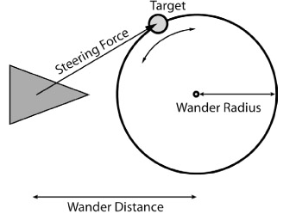
Wander
By varying the wander distance and wander radius, different effects can be achieved
Very smooth undulating turns to...
Wild Strictly Ballroom type whirls and pirouettes
Depending on the size of the circle, its distance from the vehicle, and the amount of random displacement each frame

Slide 40
In Code
Vector3 Wander()
{
float jitterTimeSlice = Params.GetFloat("wander_jitter") * timeDelta;
Vector3 toAdd = new Vector3(Utilities.RandomClamped(), Utilities.RandomClamped(), Utilities.RandomClamped()) * jitterTimeSlice;
wanderTargetPos += toAdd;
wanderTargetPos.Normalize();
wanderTargetPos *= Params.GetFloat("wander_radius");
Vector3 worldTarget = transform.TransformPoint(wanderTargetPos + (Vector3.forward * Params.GetFloat("wander_distance")));
return (worldTarget - transform.position);
}

Slide 41
Coming next...
The mother of all steering behaviours...
Obstacle Avoidance..

